Slide 1
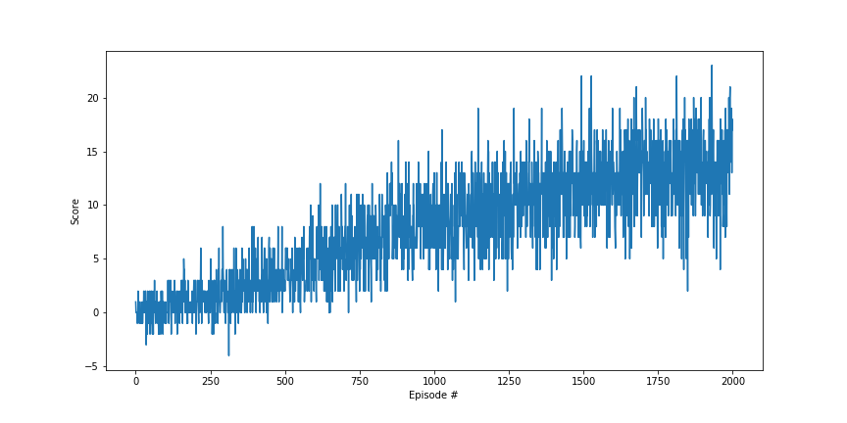
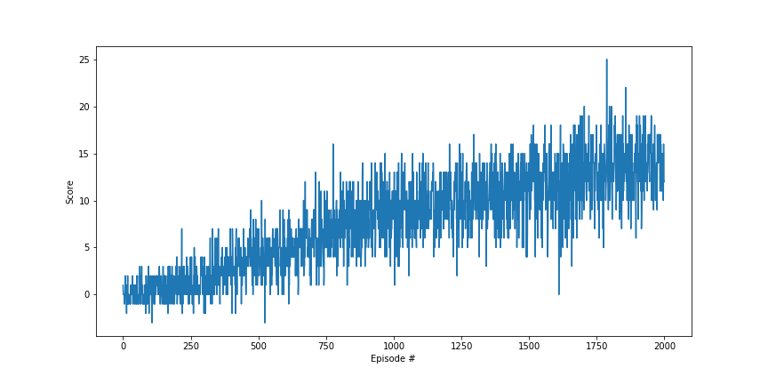
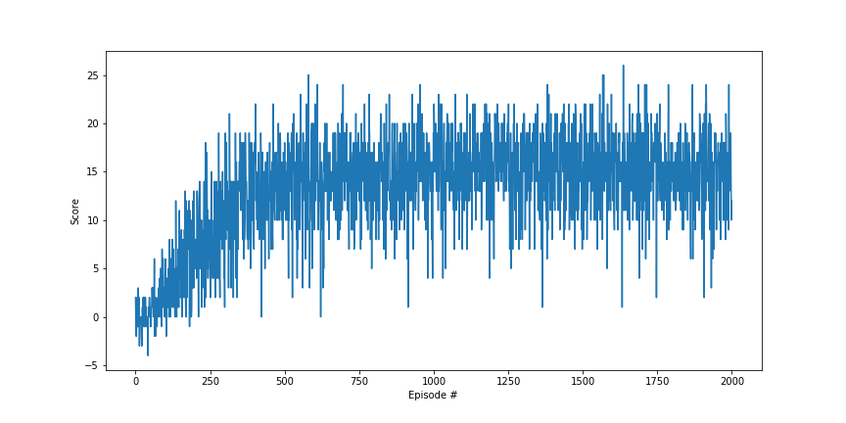
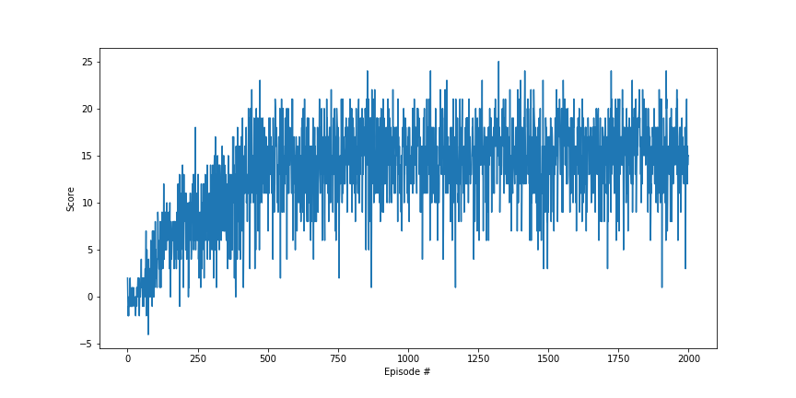
DQN + Replay Buffer
DDQN + Replay Buffer
DQN + PRE Replay Buffer
DDQN + PRE Replay Buffer

